Slide 1
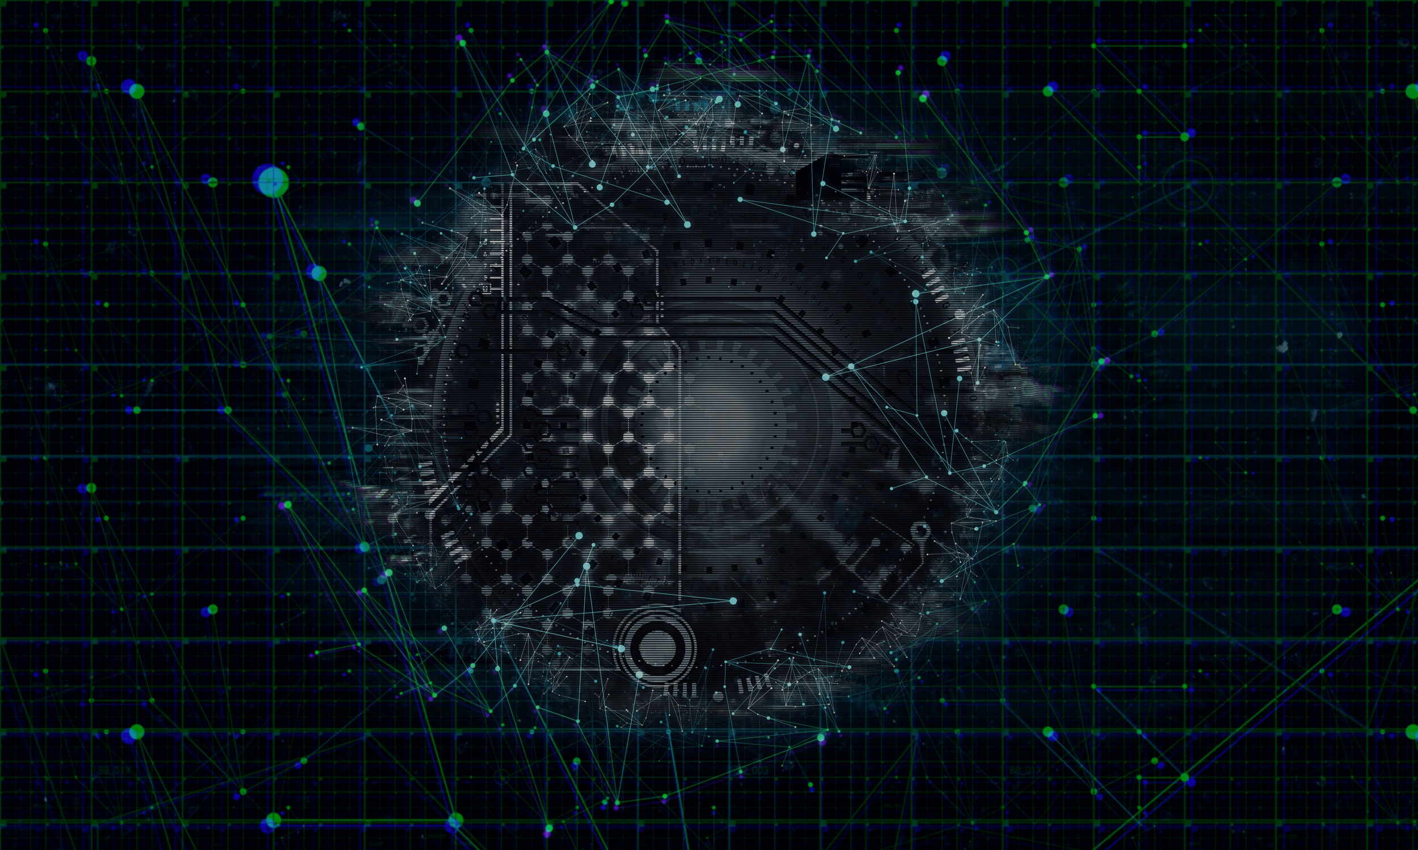


PHISHING AWARENESS TRAINING
How to Recognize and Avoid Phishing Attacks.
🧠 Stay sharp, stay safe
Presented by: Oyewole Samad Oluwasanjo.
Internship Project
PAGE 1

Slide 2
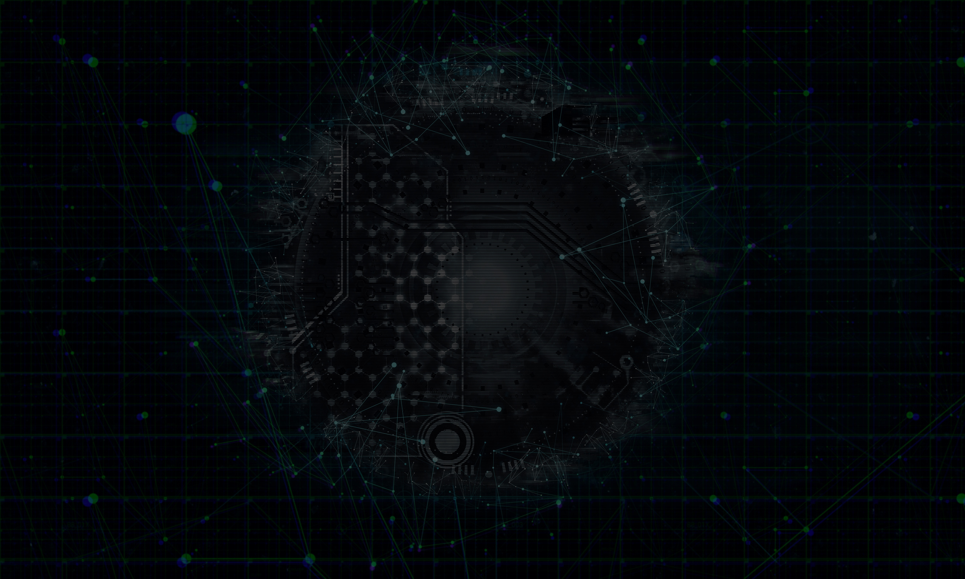
WHAT IS PHISHING ?
Phishing is a fraudulent attempts to steal sensitive information by impersonating trusted entities.Fake emails, messages, or websites designed to trick you into revealing sensitive info like; Passwords, Credit card numbers, Personal data..
For example, you might receive an email that looks like it’s from your bank, urging you to click a link and "verify" your account details. The link leads to a fake website that captures your input. Phishing attacks exploit trust and often use urgency or fear to prompt quick action.
PAGE 2

Slide 3
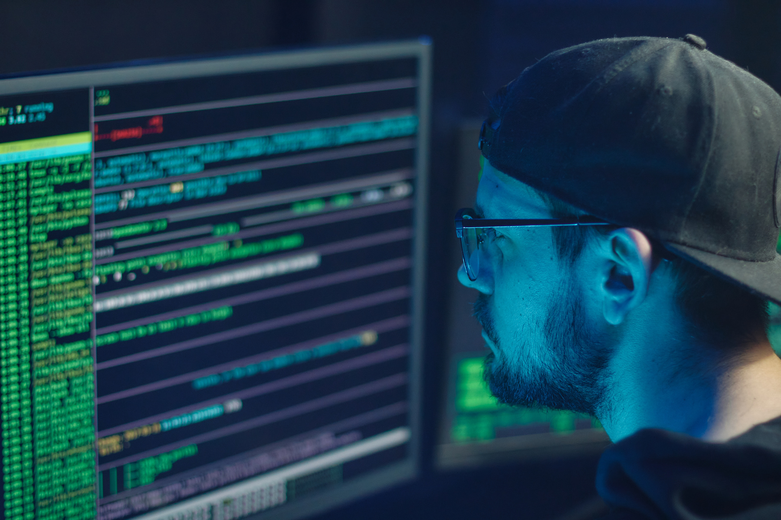
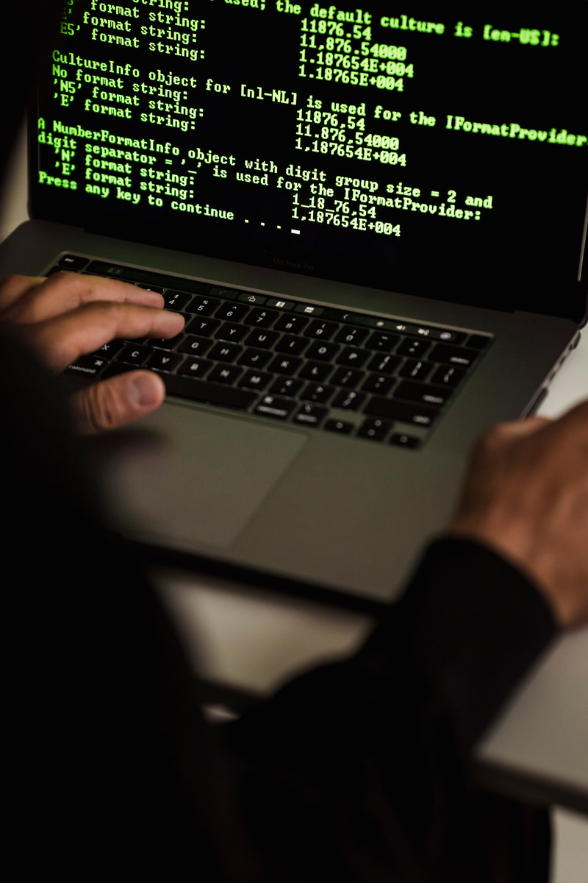
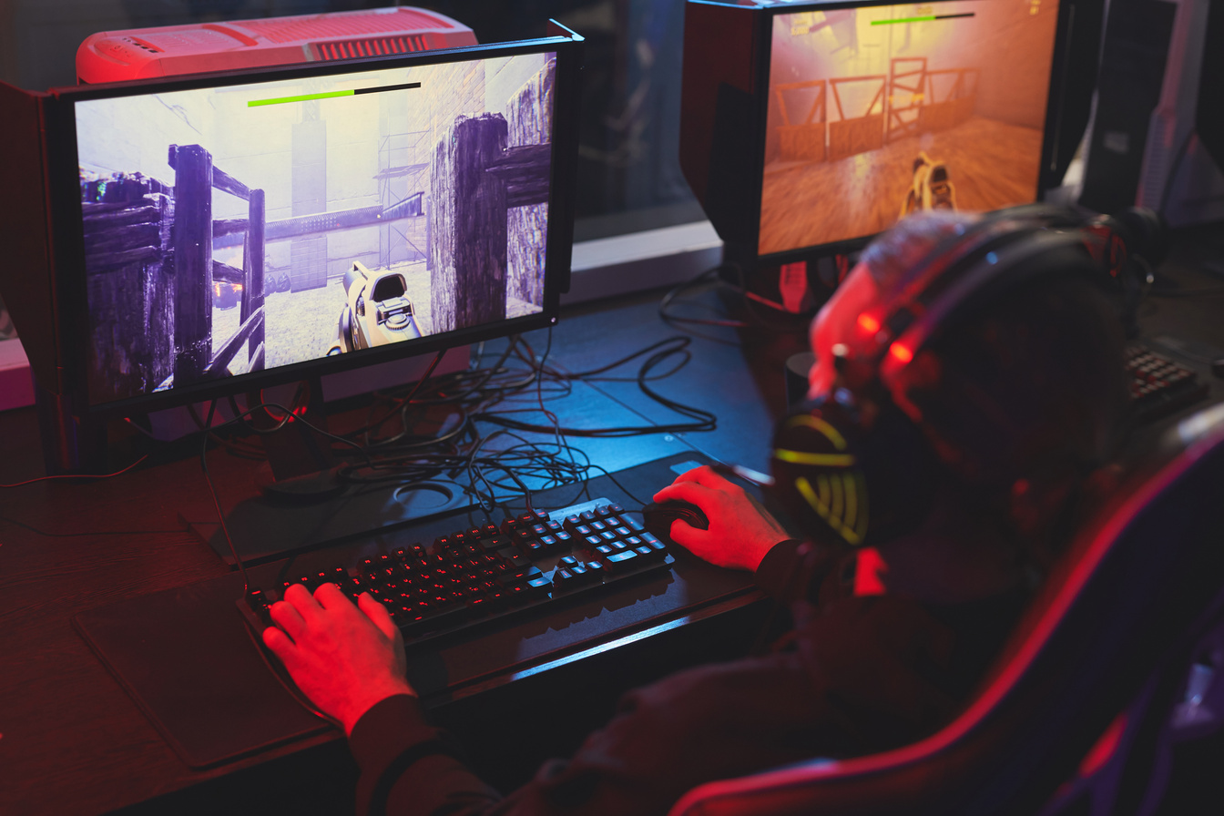
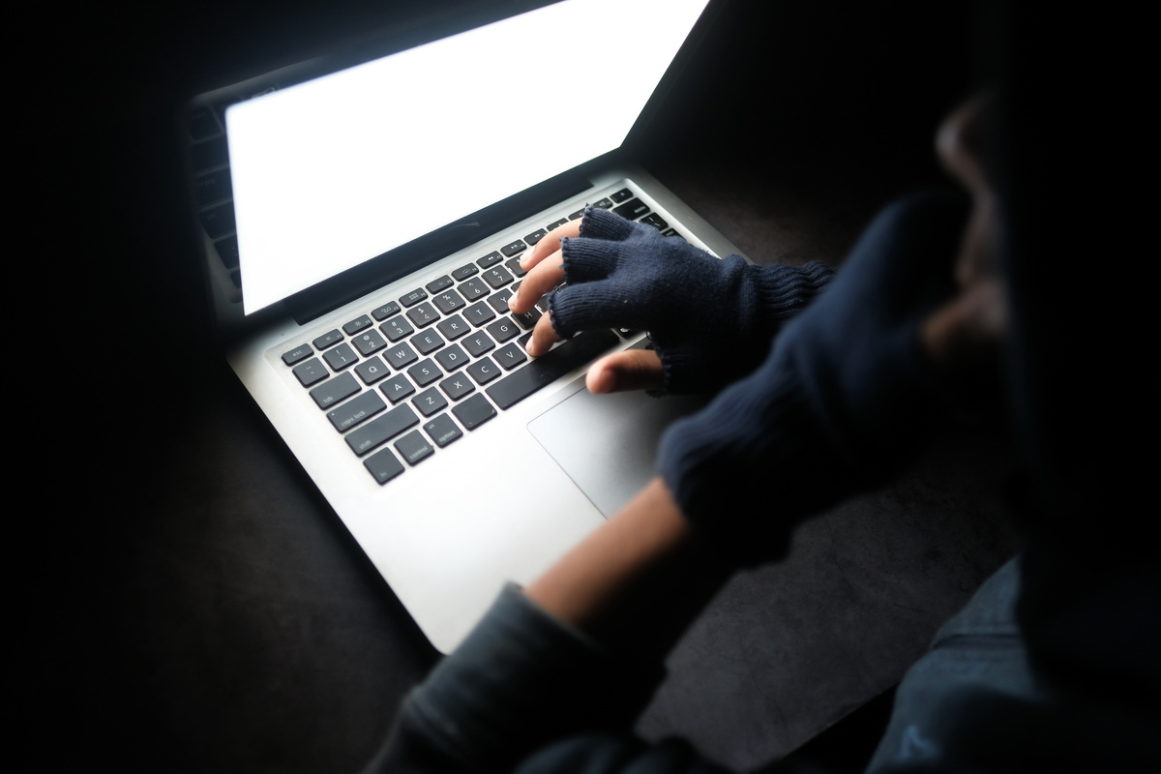
WHY IS PHISHING DANGEROUS ?
Phishing is dangerous because it exploits trust to steal sensitive information or cause harm, often leading to severe consequences like:
1.
💸 FINANCIAL LOSS
Phishing scams can trick users into providing credit card details or transferring money to fraudulent accounts. For example, a fake PayPal email might prompt a payment to a scammer.
2.
🔐 DATA BREACH
Attackers gain access to sensitive data — passwords, customer records, or business secrets.
3.
🧑 IDENTITY THEFT
Attackers can use stolen credentials (e.g., usernames, passwords, or Social Security numbers) to impersonate victims, accessing bank accounts, emails, or other personal accounts.
PAGE 3

Slide 4
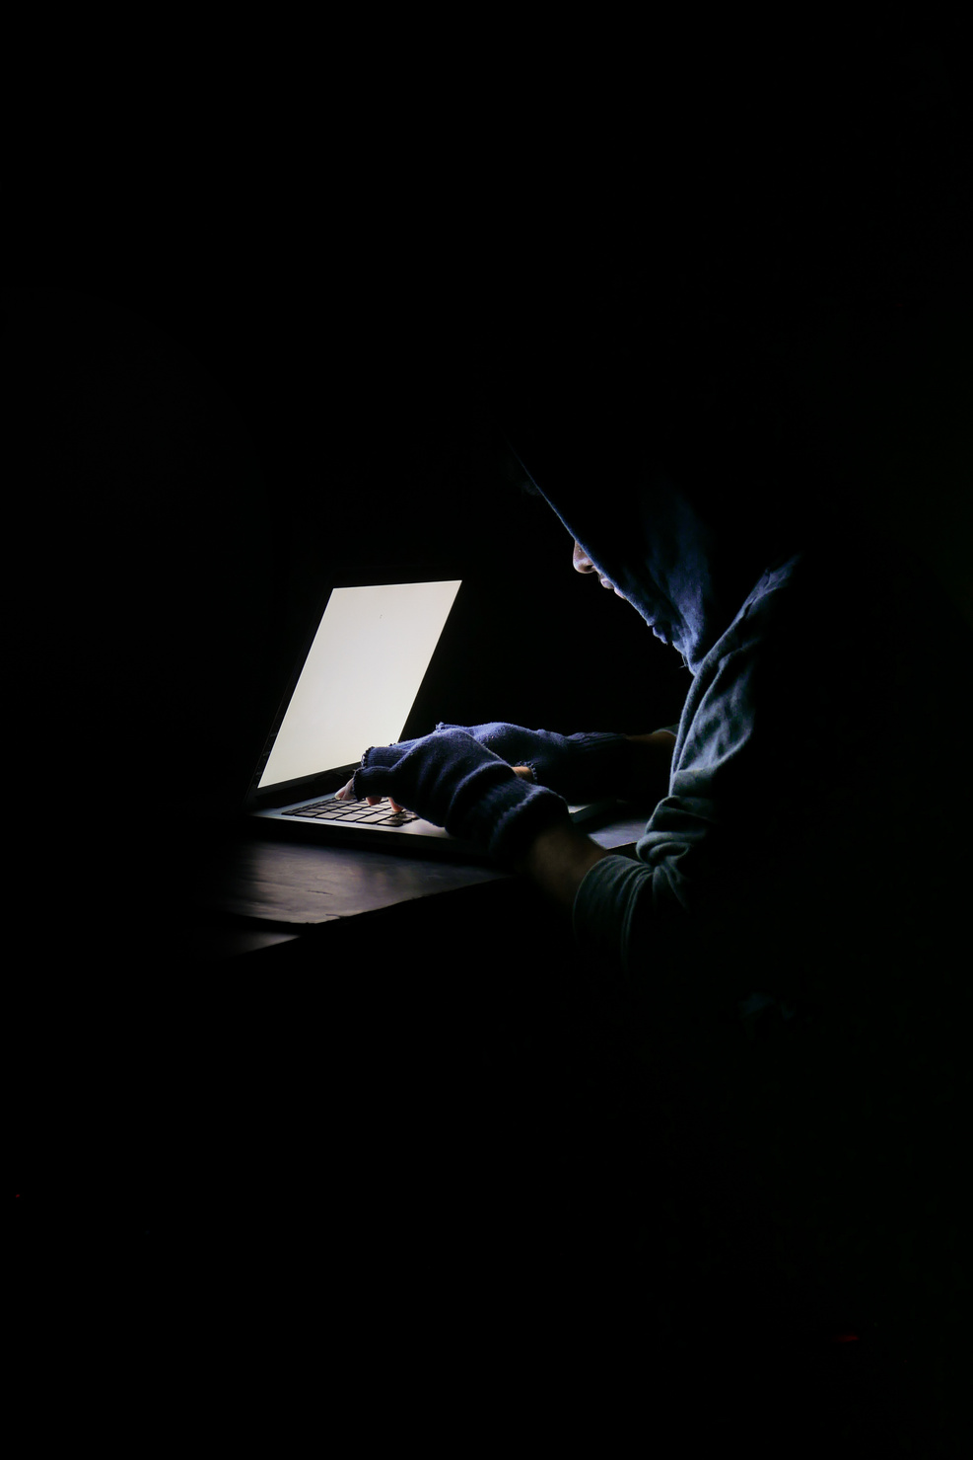
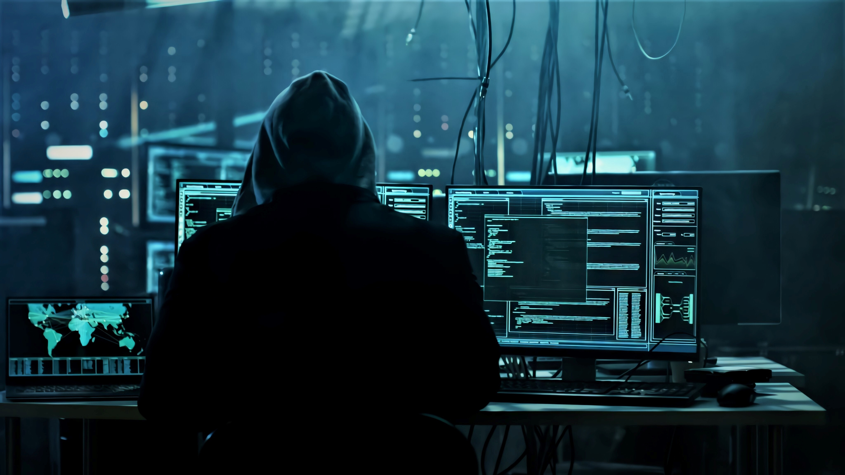
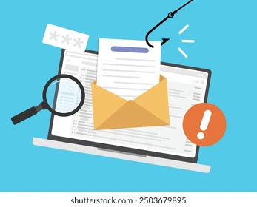
TYPES OF PHISHING
Type;- Email Phishing
Target;- General public
Example ;- "Your Netflix account is suspended”
Type ;- Pharming
Target ; - Website visitors
Example ;- Fake bank login pages
Type ;- Spear Phishing
Target ;- Specific individuals
Example ;- "Hi [You], urgent document from CEO"
Type ;- Smishing
Targeet ;- Mobile user
Example ;- "FedEx: Pay $2.50 to receive package" SMS
PAGE 4

Slide 5
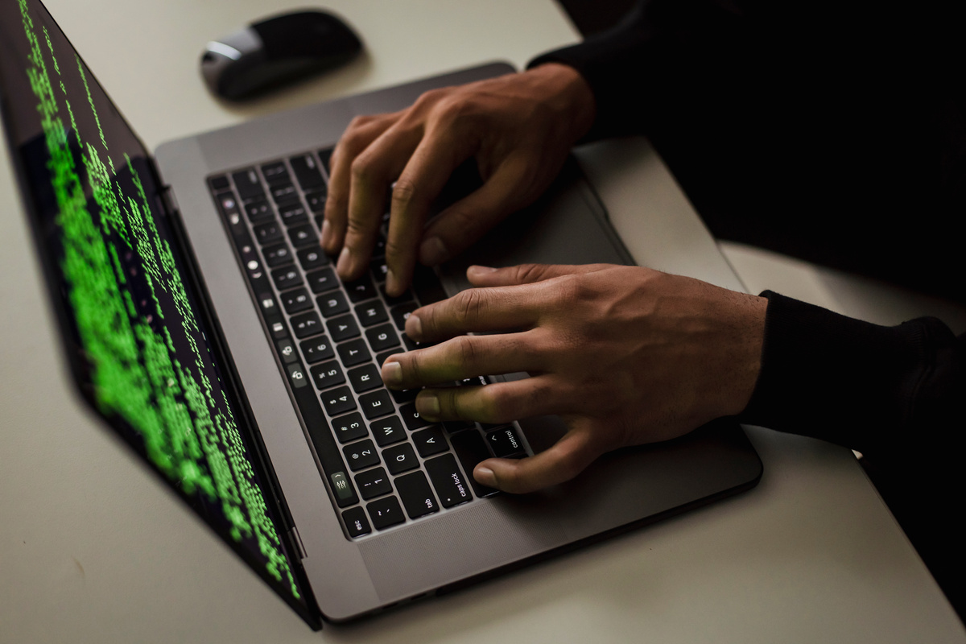
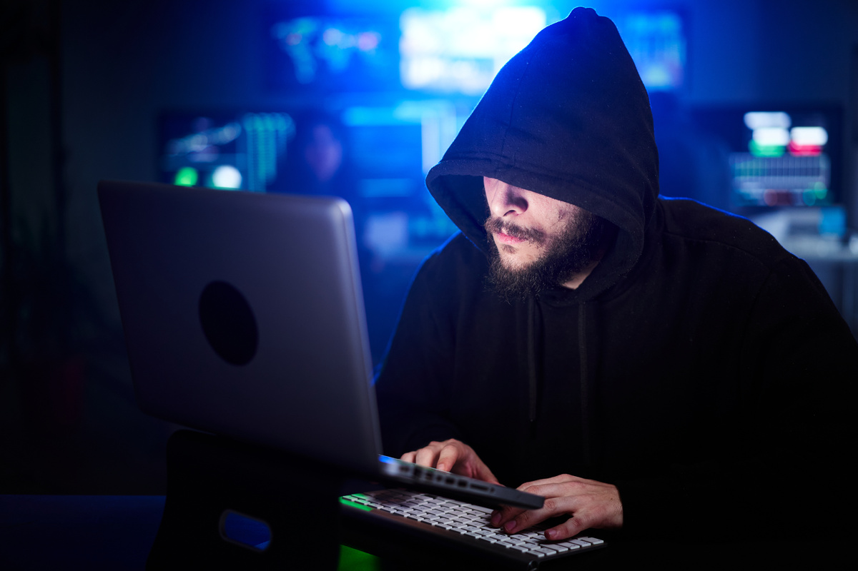
SPOT PHISHING EMAILS - RED FLAGS
1.
🚩 GENERIC GREETINGS ("DEAR CUSTOMER")
2.
🚩 URGENT/THREATENING LANGUAGE ("ACT NOW!")
3.
🚩 MISMATCHED SENDER ADDRESSES (AMAZ0N-SUPPORT@)
4.
🚩 Suspicious links (hover to preview URL)
5.
🚩 Unexpected attachments (.exe, .zip)
6
🚩 Poor grammar/spelling
7
🚩 Requests for passwords/PII
PAGE 6

Slide 6
HOW TO DETECT FAKE WEBSITE
URL Check:
Misspellings of website (paypa1.com)
Wrong domains (.net instead of .com)
2. Trust Indicators:
COMPANY LOGO QUALITY
CONTACT INFORMATION
GRAMMAR CONSISTENCY
PAGE 5

Slide 7
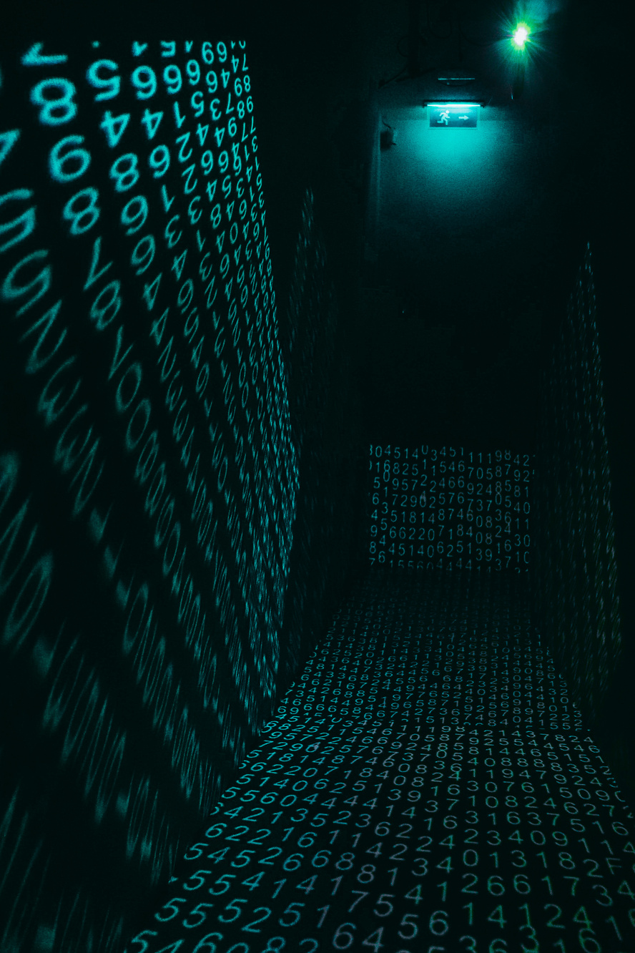
TACTICS USED BY HACKERS
1.
PRETEXTING :- FAKE SCENARIOS ("IT NEEDS YOUR PASSWORD")
2.
BAITING :- "FREE GIFT CARD" OFFERS
3
Quid Pro Quo : - "Send data for a reward"
4
Tailgating: Following into secure areas
5
Authority Exploitation: "This is your manager calling..."
PAGE 7

Slide 8
REAL-WORLD CASE STUDIES
1.
TWITTER BITCOIN SCAM (2020)
2
COLONIAL PIPELINE RANSOMWARE (2021)
Attackers compromised employee credentials via vishing
Took over celebrity accounts: "Send Bitcoin to double it!"
Loss: $118,000 in 1 day
Phishing email → Stolen VPN password → $4.4M ransom
Caused fuel shortages across US East Coast
PAGE 8

Slide 9
QUIZ
EMAIL FROM "AMAZON": "YOUR ACCOUNT WILL BE SUSPENDED! CLICK HERE TO VERIFY."
CALLER: "HI, I'M FROM MICROSOFT. YOUR COMPUTER HAS VIRUSES. WHAT'S YOUR IP?"
A. Legitimate
B. Phishing
A. Legitimate
B. Phishing
PAGE 9

Slide 10
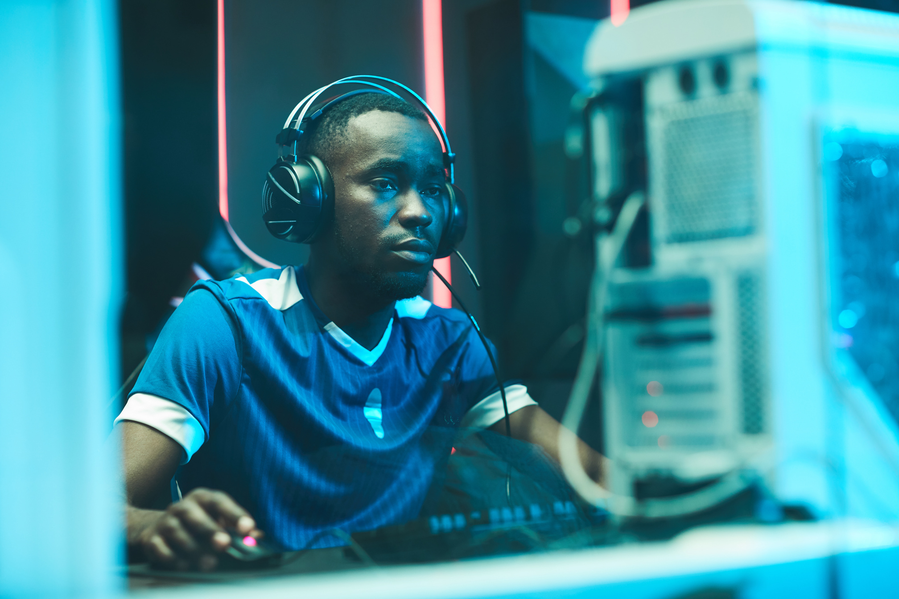
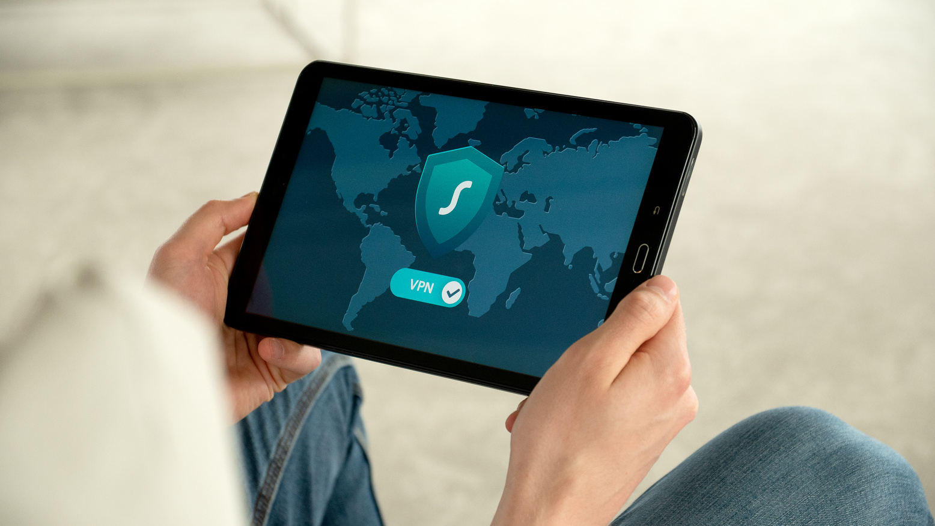
PROTECTION CHECKLIST
DO:
✅ Verify sender identities (call official numbers)
✅ Use MFA everywhere
✅ Report suspicious messages
✅ Keep software updated
DON'T:
❌ Click unexpected links/attachments
❌ Share passwords via email/phone
❌ Use public WiFi for sensitive tasks
❌ Panic over urgent requests
PAGE 10

Slide 11
INCIDENT RESPONSE
DISCONNECT FROM INTERNET
SCAN DEVICE WITH ANTIVIRUS
CHANGE PASSWORDS
CONTACT IT/SECURITY TEAM
MONITOR ACCOUNTS FOR FRAUD
PAGE 11

Slide 12

CYBERSHIELD AGAINST PHISHING
🔒 1. STAY SKEPTICAL
- Assume *every* unexpected request is guilty until proven innocent
- Remember: Legitimate companies never ask for passwords via email
📞 2. VERIFY → REPORT → DELETE
- **Verify** sender identity through official channels
- **Report** suspicious messages to IT/Security
- **Delete** anything questionable immediately
🛡️ 3. YOU ARE THE HUMAN FIREWALL
- Your vigilance protects our entire organization
- One cautious click prevents a million-dollar breach
PAGE 12

Slide 13

THANK YOU
👍🏻
Oyewole Samad
PAGE 15

